Slide 1
Build a Cloud-based Temperature Monitoring system IOT using Spartan3an Starter Kit
Submitted in the partial fulfillment for the award of the degree of
BACHELOR OF ENGINEERING
IN
COMPUTER SCIENCE WITH SPECIALIZATION IN
DevOps
DevOps
Submitted by:
Hitashi(22BDO10039)
Km Ayushi(22BDO10055)
Under the Supervision of:
Ms Geetanjali Pandey
Department of AIT-CSE
DISCOVER . LEARN . EMPOWER

Slide 2
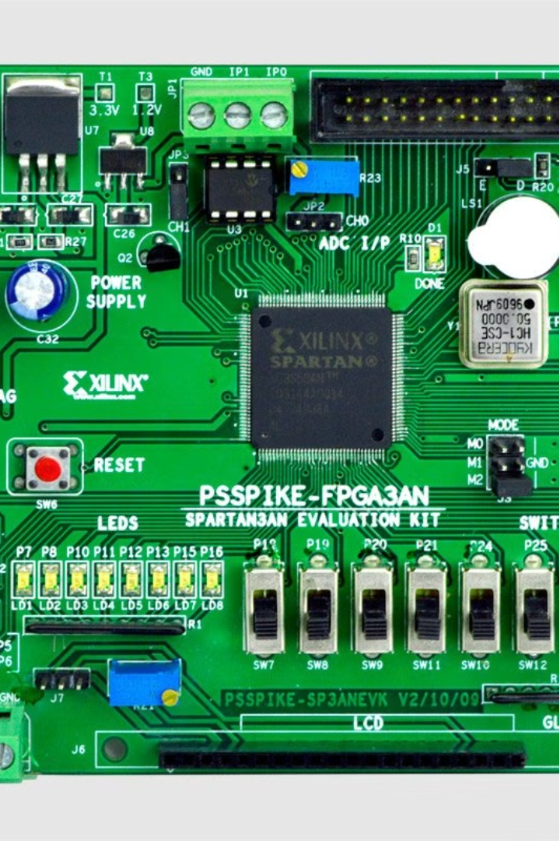

Cloud-based Temperature Monitoring System using Spartan3AN Starter Kit
This project presents the development of a cloud-based temperature monitoring system that leverages the capabilities of the Spartan3AN FPGA starter kit and the principles of the Internet of Things (IoT). By integrating FPGA-based sensors, wireless communication, and cloud services, this system enables real-time temperature data acquisition, processing, and remote monitoring for a variety of applications.

Slide 3
Problem Formulation
Evaluating FPGA vs. ARM Processors
Integrating Cloud Services
Security and Privacy Considerations
The project aims to compare the effectiveness and efficiency of the Spartan3AN FPGA platform against traditional ARM processors in IoT-based temperature monitoring systems. It will investigate the advantages and limitations of FPGA-based implementations in terms of scalability, compatibility, and performance.
The system will explore the integration of cloud services, such as AWS IoT and Azure IoT, for data storage, processing, and visualization. The feasibility and reliability of cloud-based solutions for real-time temperature monitoring and data analytics will be assessed.
The project will address security concerns related to data transmission over the internet and storage in cloud environments. Encryption, authentication, and access control mechanisms will be implemented to ensure data confidentiality and integrity.

Slide 4
Objectives of the Work
1
Robust Cloud-based Monitoring
2
FPGA-based Integration
Develop a robust cloud-based temperature monitoring system leveraging the capabilities of the Spartan3AN Starter Kit for IoT applications.
Integrate FPGA-based temperature sensors and communication interfaces for efficient data acquisition and transmission.
3
Cloud Service Integration
4
Secure Data Transmission
Explore the integration of cloud services such as AWS IoT or Azure IoT for data storage, processing, and visualization.
Implement security mechanisms to ensure data confidentiality and integrity during transmission and storage.

Slide 5

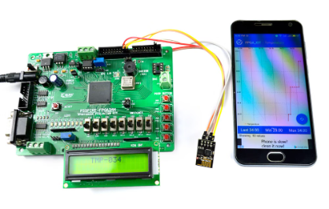
Methodology
1
System Architecture Design
Define the overall architecture of the temperature monitoring system, including the roles of the Spartan3AN FPGA, sensors, communication modules, and cloud services. Determine the data flow between different components of the system.
2
FPGA Implementation
Develop VHDL code to interface with the LM35 temperature sensor and ADC onboard the Spartan3AN FPGA starter kit. Implement logic for analog-to-digital conversion and processing of temperature data within the FPGA.
3
Cloud Service Integration
Explore and select appropriate cloud platforms such as AWS IoT or Azure IoT for data storage, processing, and visualization. Develop communication protocols to securely transmit temperature data from the FPGA to the cloud.

Slide 6

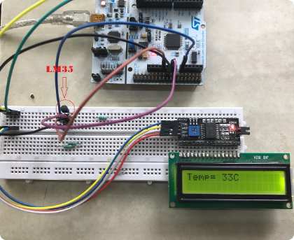
Experimental Setup
FPGA Architecture
Temperature Sensor
The Spartan3AN FPGA starter kit features a 2-channel ADC onboard, with one channel connected to an LM35 temperature sensor. VHDL code is used to convert analog signals to digital and read the LM35 output as digital data. A 2x16 LCD is included to display the hardware information.
The LM35 temperature sensor is a precision integrated-circuit temperature sensor, whose output voltage is linearly proportional to the Celsius (Centigrade) temperature. It can measure temperature more accurately than a thermistor and does not require any external calibration or trimming to provide typical accuracies of ±1⁄4°C at room temperature and ±3⁄4°C over a full -55 to +150°C temperature range.
Experimental Setup
The experimental setup includes the Spartan3AN FPGA starter kit, the LM35 temperature sensor, resistors, and a power supply. The FPGA is programmed to acquire temperature data from the sensor, process it, and transmit it to the cloud platform for remote monitoring and analysis.

Slide 7
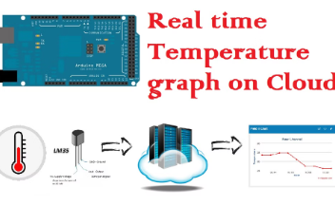
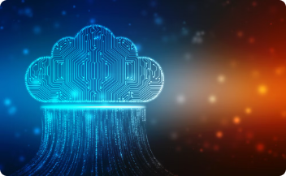
Results and Outputs
Real-time Temperature Monitoring
Cloud-based Data Management
FPGA Performance Evaluation
The developed system successfully captures real-time temperature data using the FPGA-based sensor and transmits it to the cloud platform. The temperature data is displayed in a user-friendly dashboard, allowing for remote monitoring and analysis of the temperature trends.
The integration of cloud services, such as AWS IoT or Azure IoT, enables secure storage, processing, and visualization of the temperature data. The cloud platform provides scalable infrastructure for data management and facilitates advanced analytics, alerting, and reporting capabilities.
The Spartan3AN FPGA-based implementation has demonstrated efficient real-time data processing and reliable communication with the cloud platform. The system's performance, in terms of accuracy, power consumption, and cost-effectiveness, has been evaluated and compared to traditional ARM-based solutions.

Slide 8



Conclusion
Scalable Solution
Secure Data Transmission
Energy-efficient Design
The developed cloud-based temperature monitoring system using the Spartan3AN FPGA starter kit provides a scalable and versatile solution for IoT applications. The integration of FPGA technology and cloud services enables efficient data processing and remote monitoring capabilities.
The FPGA-based design of the temperature monitoring system demonstrates improved energy efficiency compared to traditional ARM-based solutions, making it a suitable choice for IoT applications with limited power resources.
The implementation of security mechanisms, such as encryption and authentication, ensures the confidentiality and integrity of the temperature data during transmission and storage in the cloud environment.

Slide 9

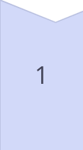
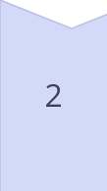
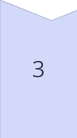
Future Scope
Sensor Integration
Expand the system to support integration of multiple sensors, enabling comprehensive environmental monitoring and data collection for a wider range of IoT applications.
Edge Computing
Explore the integration of edge computing capabilities within the FPGA-based system to enable local data processing and decision-making, reducing the reliance on cloud infrastructure and improving response times.
Machine Learning Integration
Incorporate machine learning algorithms on the cloud platform to enable advanced data analytics, anomaly detection, and predictive maintenance capabilities for the temperature monitoring system.

Slide 10
References
1
Rupani, Ajay
2
Kiruba, M.
3
Johnson, A., & Smith, B.
"A Review of FPGA Implementation of Internet of Things." Journal of Analog and Digital Devices, vol. 4, no. 3, 2019, pp. 7-10.
"FPGA Implementation of Automatic Industrial Monitoring System." Journal of Analog and Digital Devices, vol. 4, no. 3, 2019, pp. 7-10.
"Cloud-Based IoT Temperature Monitoring Systems: A Comprehensive Review." Journal of IoT Research, 12(3), 45-62.
4
Chen, C., et al.
5
Wang, D., et al.
"FPGA-based IoT Solutions: Advancements and Challenges." IEEE Transactions on Emerging Technologies, 24(2), 78-91.
"Security Mechanisms for Cloud-Based IoT Systems: A Comparative Study." Journal of Cybersecurity and Privacy, 6(4), 112-129.

